Slide 1
I/O in java
In java stream based input/output is supported.
A stream is an abstraction for flow of data.
This is either a source or a destination for the data
It behaves uniformaly irrespective of what type of device is connected at the ends.

Slide 2
Topics(Ch13 &19)
Predefined streams
InputStream,Outputstream,
FileInputStream,FileoutputStream
PrintStream
Reader,Writer
FileReader,FileWriter,
Buffered Reader,BufferedWriter,PrintWriter
RandomAccessFile, File,directories,FilenameFilter
Serialization

Slide 3
Standard(predefined)Streams
System.in,System.out,System.err
In,out,err are public ,static,and final members of System class
They are of following class type
in:InputStream(reference to abstract class)
out: PrintStream
err: PrintStream
In is connected to stdin,out is to stdout and err is to stdout by default.

Slide 4
Type of streams
Byte streams: byte oriented I/O
Base classes are
InputStream and OutputStream
(both abstract)
Character streams: char oriented I/O
Base classes are
Reader and Writer (both abstract)
Support for unicode character.

Slide 5
Buffered Streams
Both character oriented and byte oriented streams can be buffered and classes are available for use again in java library.

Slide 6
Java API support
For streams ,the java library(API) is the package named “java.io”
Importing this is must in programs having stream oriented io.

Slide 7
Reading Console Input
Reading Characters and Strings
BufferedReader br=new BufferedReader
(new InputStreamReader(System.in));
char ch=(char)br.read();
String str=br.readLine();
For reading other types use wrapper classes to convert String to corresponding type.

Slide 8
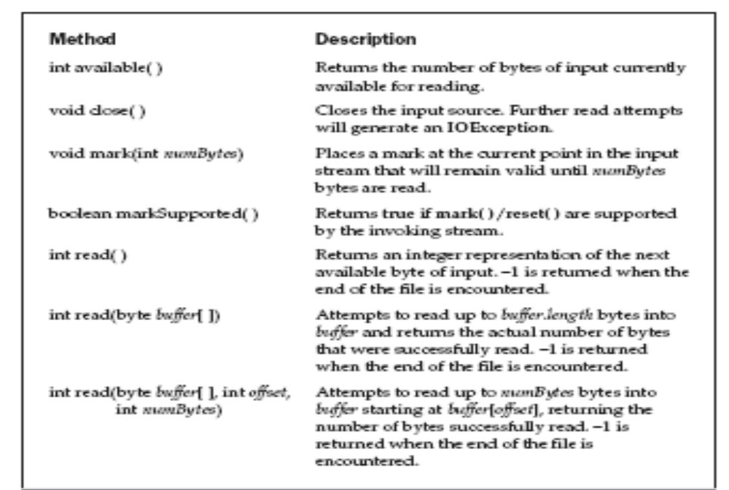
InputStream Methods

Slide 9


Slide 10
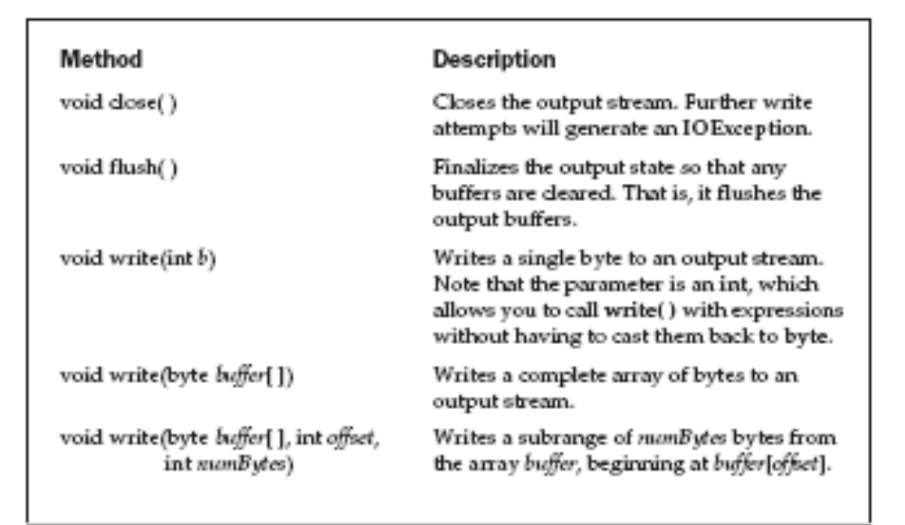
OutputStream methods

Slide 11
FileInputStream
The FileInputStream class creates an InputStream that you can use to read bytes from a file. Its two most common constructors are shown here:
FileInputStream(String filepath)
FileInputStream(File fileObj)
Either can throw a FileNotFoundException. Here, filepath is the full path name of a file,
and fileObj is a File object that describes the file.
The following example creates two FileInputStreams that use the same disk file and each of the two constructors:
FileInputStream f0 = new FileInputStream("/autoexec.bat")
File f = new File("/autoexec.bat");
FileInputStream f1 = new FileInputStream(f);

Slide 12
FileInputStream overrides six of the methods in the abstract class InputStream.
The mark( ) and reset( ) methods are not overridden, and any attempt to use reset( ) on aFileInputStream will generate an IOException.
The next example shows how to read a single byte, an array of bytes, and a subrange array of bytes. It also illustrates how to use available( ) to determine the number of bytes remaining, and how to use the skip( ) method to skip over unwanted bytes. The program reads its own source file, which must be in the current directory.

Slide 13
// Demonstrate FileInputStream.
import java.io.*;
class FileInputStreamDemo {
public static void main(String args[]) throws Exception {
int size;
InputStream f =
new FileInputStream("FileInputStreamDemo.java");
System.out.println("Total Available Bytes: " +
(size = f.available()));

Slide 14
int n = size/40;
System.out.println("First " + n +
" bytes of the file one read() at a time");
for (int i=0; i < n; i++) {
System.out.print((char) f.read());
}
System.out.println("\nStill Available: " + f.available());
System.out.println("Reading the next " + n +
" with one read(b[])");

Slide 15
byte b[] = new byte[n];
if (f.read(b) != n) {
System.err.println("couldn't read " + n + " bytes.");
}
System.out.println(new String(b, 0, n));
System.out.println("\nStill Available: " + (size = f.available()));
System.out.println("Skipping half of remaining bytes with skip()");
f.skip(size/2);
System.out.println("Still Available: " + f.available());

Slide 16
System.out.println("Reading " + n/2 + " into the end of array");
if (f.read(b, n/2, n/2) != n/2) {
System.err.println("couldn't read " + n/2 + " bytes.");
}
System.out.println(new String(b, 0, b.length));
System.out.println("\nStill Available: " + f.available());
f.close();
}
}

Slide 17
o/p
Total Available Bytes: 1444
First 36 bytes of the file one read() at a time
import java.io.*;
class FileInp
Still Available: 1408
Reading the next 36 with one read(b[])
utStreamDemo {
public static void
Still Available: 1372
Skipping half of remaining bytes with skip()
Still Available: 686
Reading 18 into the end of array
utStreamDemo {
if (f.read(b) != n
Still Available: 668

Slide 18
FileOutputStream
FileOutputStream creates an OutputStream that you can use to write bytes to a file. Its most commonly used constructors are shown here:
FileOutputStream(String filePath)
FileOutputStream(File fileObj)
FileOutputStream(String filePath, boolean append)
FileOutputStream(File fileObj, boolean append)
They can throw a FileNotFoundException or a SecurityException. Here, filePath is the full path name of a file, and fileObj is a File object that describes the file. If append is true, the file is opened in append mode. The fourth constructor was added by Java 2, version 1.4.
Creation of a FileOutputStream is not dependent on the file already existing.
FileOutputStream will create the file before opening it for output when you create
the object. In the case where you attempt to open a read-only file, an IOException
will be thrown.

Slide 19
// Demonstrate FileOutputStream.
import java.io.*;
class FileOutputStreamDemo {
public static void main(String args[]) throws Exception {
String source = "Now is the time for all good men\n"
+ " to come to the aid of their country\n"
+ " and pay their due taxes.";
byte buf[] = source.getBytes();
OutputStream f0 = new FileOutputStream("file1.txt");
for (int i=0; i < buf.length; i += 2) {

Slide 20
f0.write(buf[i]);
}
f0.close();
OutputStream f1 = new FileOutputStream("file2.txt");
f1.write(buf);
f1.close();
OutputStream f2 = new FileOutputStream("file3.txt");
f2.write(buf,buf.length-buf.length/4,buf.length/4);
f2.close();
}
}

Slide 21
O/p
Here are the contents of each file after running this program. First, file1.txt:
Nwi h iefralgo e
t oet h i ftercuty n a hi u ae.
Next, file2.txt:
Now is the time for all good men
to come to the aid of their country
and pay their due taxes.
Finally, file3.txt:
nd pay their due taxes.

Slide 22
Show FileExample(byte streams)
import java.io.*;
class ShowFile {
public static void main(String args[])
throws IOException
{
int i;
FileInputStream fin;
try {
fin = new FileInputStream(args[0]);
} catch(FileNotFoundException e) {
System.out.println("File Not Found");
return;

Slide 23
Contd….
} catch(ArrayIndexOutOfBoundsException e) {
System.out.println("Usage: ShowFile File");
return;
}
// read characters until EOF is encountered
do {
i = fin.read();
if(i != -1) System.out.print((char) i);
} while(i != -1);
fin.close();
}
}

Slide 24
Copy File
import java.io.*;
class CopyFile {
public static void main(String args[])
throws IOException
{
int i;
FileInputStream fin;
FileOutputStream fout;
try {
// open input file

Slide 25
Copy File
try {
fin = new FileInputStream(args[0]);
} catch(FileNotFoundException e) {
System.out.println("Input File Not Found");
return;
}
// open output file
try {
fout = new FileOutputStream(args[1]);
} catch(FileNotFoundException e) {

Slide 26
Copy one
System.out.println("Error Opening Output File");
return;
}
} catch(ArrayIndexOutOfBoundsException e) {
System.out.println("Usage: CopyFile From To");
return;
}
// Copy File
try {
do {

Slide 27
Copy one
i = fin.read();
if(i != -1) fout.write(i);
} while(i != -1);
} catch(IOException e) {
System.out.println("File Error");
}
fin.close();
fout.close();
}
}

Slide 28
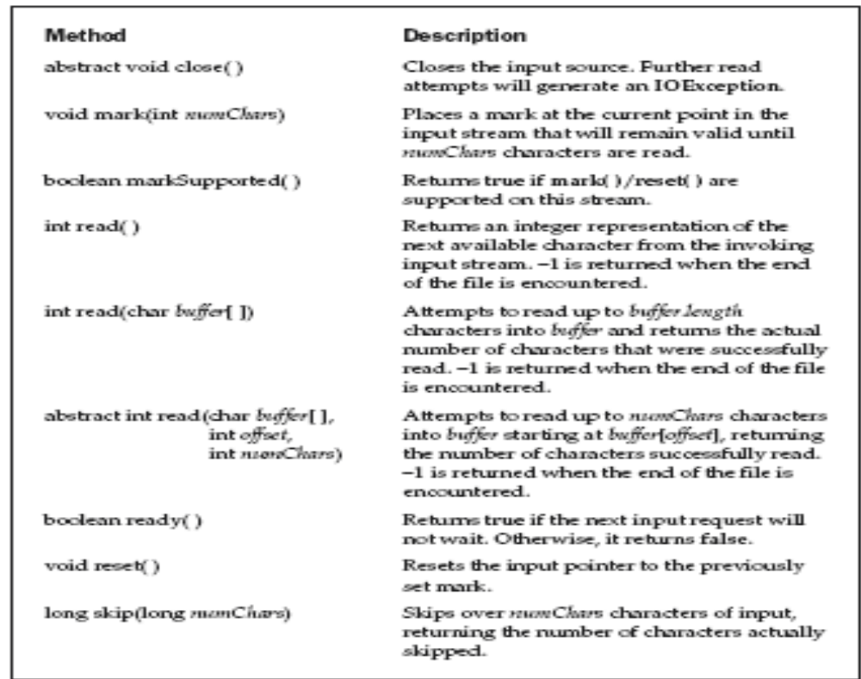
Reader and Writer

Slide 29
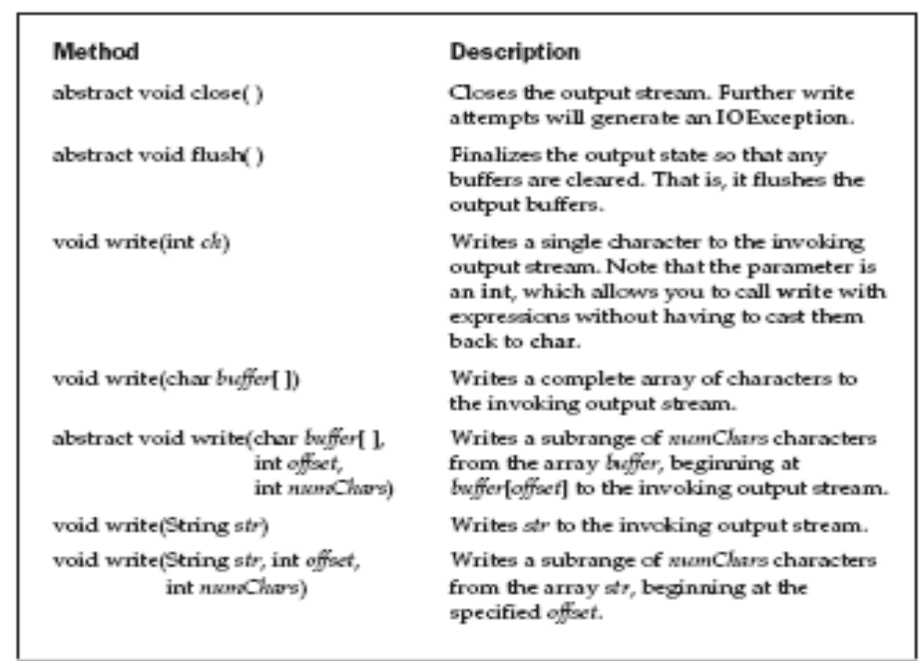
Writer

Slide 30
FileReader
FileReader(String filePath)
FileReader(File fileObj)
Either can throw a FileNotFoundException.
Here, filePath is the full path name of a file,
and fileObj is a File object that describes the file.

Slide 31
FileReader
// Demonstrate FileReader.
import java.io.*;
class FileReaderDemo {
public static void main(String args[]) throws Exception {
FileReader fr = new FileReader("FileReaderDemo.java");
BufferedReader br = new BufferedReader(fr);
String s;
while((s = br.readLine()) != null) {
System.out.println(s);
}
fr.close();
}
}

Slide 32
FileWriter
FileWriter(String filePath)
FileWriter(String filePath, boolean append)
FileWriter(File fileObj)
FileWriter(File fileObj, boolean append)
They can throw an IOException. Here, filePath is the full path name of a file, and fileObj is a File object that describes the file. If append is true, then output is appended to the end of the file.
Creation of a FileWriter is not dependent on the file already existing. FileWriter will create the file before opening it for output when you create the object. In the case where you attempt to open a read-only file, an IOException will be thrown.

Slide 33
// Demonstrate FileWriter.
import java.io.*;
class FileWriterDemo {
public static void main(String args[]) throws Exception {

Slide 34
FileWriter
String source = "Now is the time for all good men\n"
+ " to come to the aid of their country\n"
+ " and pay their due taxes.";
char buffer[] = new char[source.length()];
source.getChars(0, source.length(), buffer, 0);
FileWriter f0 = new FileWriter("file1.txt");
for (int i=0; i < buffer.length; i += 2) {
f0.write(buffer[i]);
}

Slide 35
FileWriter
f0.close();
FileWriter f1 = new FileWriter("file2.txt");
f1.write(buffer);
f1.close();
FileWriter f2 = new FileWriter("file3.txt");
f2.write(buffer,buffer.length-buffer.length/4,buffer.length/4);
f2.close();
}
}

Slide 36
BufferedReader
BufferedReader(Reader inputStream)
BufferedReader(Reader inputStream, int bufSize)
The first form creates a buffered character stream using a default buffer size. In the second, the size of the buffer is passed in bufSize.
As is the case with the byte-oriented stream, buffering an input character stream
also provides the foundation required to support moving backward in the stream
within the available buffer. To support this, BufferedReader implements the mark( )
and reset( ) methods, and BufferedReader.markSupported( ) returns true.

Slide 37
BufferedReader
import java.io.*;
class BRReadLines {
public static void main(String args[])
throws IOException
{
// create a BufferedReader using System.in
BufferedReader br = new BufferedReader(new
InputStreamReader(System.in));
String str;
System.out.println("Enter lines of text.");
System.out.println("Enter 'stop' to quit.");
do {
str = br.readLine();
System.out.println(str);
} while(!str.equals("stop"));
}
}

Slide 38
BufferedWriter
BufferedWriter(Writer outputStream)
BufferedWriter(Writer outputStream, int bufSize)

Slide 39
PrintStream
PrintStream(Outputstream os)
PrintStream(OutputStream os, boolean flushOnNewline)
FlushOnNewline=true=>automatic flushing
Otherwise it is not done
This is not supporting all unicode,Hence use of System.out, is not recommemended

Slide 40
PrintWriter
PrintWriter is essentially a character-oriented version of PrintStream. It provides the formatted output methods print( ) and println( ). PrintWriter has four constructors:
PrintWriter(OutputStream outputStream)
PrintWriter(OutputStream outputStream, boolean flushOnNewline)
PrintWriter(Writer outputStream)
PrintWriter(Writer outputStream, boolean flushOnNewline)
where flushOnNewline controls whether Java flushes the output stream every time println( ) is called. If flushOnNewline is true, flushing automatically takes place. If false,flushing is not automatic. The first and third constructors do not automatically flush.
Java’s PrintWriter objects support the print( ) and println( ) methods for all types,
including Object. If an argument is not a simple type, the PrintWriter methods will call the object’s toString( ) method and then print out the result.

Slide 41
PrintWriter
//Use printWriter in internationalized pgms
// Demonstrate PrintWriter
import java.io.*;
public class PrintWriterDemo {
public static void main(String args[]) {
PrintWriter pw = new PrintWriter(System.out, true);
pw.println("This is a string");
int i = -7;
pw.println(i);
double d = 4.5e-7;
pw.println(d);
}
}

Slide 42
File
It deals with File system directly
It defines many methods that obtain standard properties of files.
Some constructors of this class are
File(String dirpath)
File(String dirpath,String fname);
File(File dirObj, String filename)
File(URI uriObj)
Delete,rename etc can also be done
Examples
File f1=new File(“/Program Files/Java/A.java”);
File f2=new File(“/”,”fi.txt”);

Slide 43
File
listing 1
// Demonstrate File.
import java.io.File;
class FileDemo {
static void p(String s) {
System.out.println(s);
}
public static void main(String args[]) {
File f1 = new File("/java/COPYRIGHT");
p("File Name: " + f1.getName());
p("Path: " + f1.getPath());

Slide 44
File
p("Abs Path: " + f1.getAbsolutePath());
p("Parent: " + f1.getParent());
p(f1.exists() ? "exists" : "does not exist");
p(f1.canWrite() ? "is writeable" : "is not writeable");
p(f1.canRead() ? "is readable" : "is not readable");
p("is " + (f1.isDirectory() ? "" : "not" + " a directory"));
p(f1.isFile() ? "is normal file" : "might be a named pipe");
p(f1.isAbsolute() ? "is absolute" : "is not absolute");
p("File last modified: " + f1.lastModified());
p("File size: " + f1.length() + " Bytes");
}
}

Slide 45
o/p
File Name: COPYRIGHT
Path: /java/COPYRIGHT
Abs Path: /java/COPYRIGHT
Parent: /java
exists
is writeable
is readable
is not a directory
is normal file
is absolute
File last modified: 812465204000
File size: 695 Bytes

Slide 46
File
File also includes two useful utility methods. The first is renameTo( ), shown here:
boolean renameTo(File newName)
Here, the filename specified by newName becomes the new name of the invoking File object. It will return true upon success and false if the file cannot be renamed (if you either attempt to rename a file so that it moves from one directory to another or use an existing filename, for example).
The second utility method is delete( ), which deletes the disk file represented by the path of the invoking File object.
boolean delete( )
You can also use delete( ) to delete a directory if the directory is empty. delete( ) returns true if it deletes the file and false if the file cannot be removed.
.

Slide 47
Directories
A directory is a File that contains a list of other files and directories. When you create a
File object and it is a directory, the isDirectory( ) method will return true. In this case,
you can call list( ) on that object to extract the list of other files and directories inside.
It has two forms. The first is shown here:
String[ ] list( )
The list of files is returned in an array of String objects.

Slide 48
List dir contents
// Using directories.
import java.io.File;
class DirList {
public static void main(String args[]) {
String dirname = "/java";
File f1 = new File(dirname);
if (f1.isDirectory()) {
System.out.println("Directory of " + dirname);
String s[] = f1.list();
for (int i=0; i < s.length; i++) {
File f = new File(dirname + "/" + s[i]);

Slide 49
Contd
if (f.isDirectory()) {
System.out.println(s[i] + " is a directory");
} else {
System.out.println(s[i] + " is a file");
}
}
} else {
System.out.println(dirname + " is not a directory");
}
}
}

Slide 50
Using FilenameFilter
You will often want to limit the number of files returned by the list( ) method to include only those files that match a certain filename pattern, or filter. To do this, you must use a second form of list( )
String[ ] list(FilenameFilter FFObj)
In this form, FFObj is an object of a class that implements the FilenameFilter interface.

Slide 51
FilenameFilter defines only a single method, accept( ), which is called once for each file in a list. Its general form is given here:
boolean accept(File directory, String filename)
The accept( ) method returns true for files in the directory specified by directory that should be included in the list (that is, those that match the filename argument), and returns false for those files that should be excluded.

Slide 52
import java.io.*;
public class OnlyExt implements FilenameFilter {
String ext;
public OnlyExt(String ext) {
this.ext = "." + ext;
}
public boolean accept(File dir, String name) {
return name.endsWith(ext);
}
}

Slide 53
// Directory of .HTML files.
import java.io.*;
class DirListOnly {
public static void main(String args[]) {
String dirname = "/java";
File f1 = new File(dirname);
FilenameFilter only = new OnlyExt("html");
String s[] = f1.list(only);
for (int i=0; i < s.length; i++) {
System.out.println(s[i]);
}
}
}

Slide 54
Creating Directories
Another two useful File utility methods are mkdir( ) and mkdirs( ).
The mkdir( ) method creates a directory, returning true on success and false on failure. Failure indicates that the path specified in the File object already exists, or that the directory cannot be created because the entire path does not exist yet. To create a directory for which no path exists, use the mkdirs( ) method. It creates both a directory and all the parents of the directory.

Slide 55
DataInputStream and DataOutputStream
These help us to write or read primitive data to and from the stream. They implement DataInput and DataOutput inerfaces.
DataOutputStream extends FilterOutputStream which extends OutputStream.
DataOutputStream(OutputStream os);

Slide 56
DataOutput interface has following type methods
final void writeDouble(double val) throws IOException
final void writeInt(int val) throws IOException
Final void writeBoolean(boolean val)throws IOException

Slide 57
These methods convert values of primitive types to bytesequence and then writes them to underlying stream.
DataInputStream extends FilterInputStream and implements DataInput interface containing following type of method.
These mehods read a sequence of bytes and convert them to primitive type.

Slide 58
double readDouble() throws IOException
boolean readBoolean() throws IOException
int readInt() throws IOException

Slide 59
import java.io.*;
class DataIODemo{
public static void main(String s[]) throws IOException
{
FileOutputStream fout=new FileOutputStream(“test.dat”);
DataOutputStream ds=new DataOutputStream(fout);
ds.writeDouble(98.7); ds.writeInt(1000);
ds.writeBoolean(true); ds.close();
FileInputStream fin=new FileInputStream(“test.dat”);
DataInputStream din=new DataInputStream(fin);
double d=din.readDouble(); int k=din.readInt();
boolean b=din.readBoolean(); din.close();
System.out.println(d+” “+k+” “+b);
}

Slide 60
RandomAccessFile
RandomAccessFile encapsulates a random-access file. It is not derived from InputStream or OutputStream. Instead, it implements the interfaces DataInput and DataOutput, which define the basic I/O methods. It also supports positioning requests—that is, you can position the file pointer within the file.
RandomAccessFile(File fileObj, String access)
throws FileNotFoundException
RandomAccessFile(String filename, String access)
throws FileNotFoundException

Slide 61
access determines what type of file access is permitted. If it is “r”, then the file can be read, but not written. If it is “rw”, then the file is opened in read-write mode. If it is “rws”, the file is opened for read-write operations and every change to the file’s data or metadata will be immediately written to the physical device. If it is “rwd”, the file is opened for
read-write operations and every change to the file’s data will be immediately written to the physical device.
The method seek( ), shown here, is used to set the current position of the file pointer within the file:
void seek(long newPos) throws IOException
Here, newPos specifies the new position, in bytes, of the file pointer from the beginning of the file. After a call to seek( ), the next read or write operation will occur at the new file position.

Slide 62
RandomAccessFile implements the standard input and output methods, which you can use to read and write to random access files. It also includes some additional methods. One is setLength( ). It has this signature:
void setLength(long len) throws IOException
This method sets the length of the invoking file to that specified by len. This method can be used to lengthen or shorten a file. If the file is lengthened, the added portion is undefined.

Slide 63
Console class
It is used to readfrom or write to console.
Console object is got from following method call from System class
static Console console()
If the console is available then a reference to it is returned.Otherwise null
Some methods of console class are

Slide 64
void flush() causes buffered output to be actually written to the console.
Console format(String fmtstr,Object …args) writes args to the console using the format specified by the fmtstr.
Console printf(String fmtstr,Object …a) similar to format
Reader reader() returns a reference to reader stream connected to the console.
String readLine() returns the string read from console upto enter.On end of stream returns null.On error throws IOError exception
String readLine(String fmtstr,Object…args)Displays prompting string as specified by the arguments and then reads and returns a string entered at keyboard.

Slide 65
char[] readPassword()
char[] readPassword(String fmtstr, Object…a)
PrintWriter writer() returns a reference to the Writer stream connected to the console.

Slide 66
import java.io.*;
class ConsoleDemo{
public static void main(String []a){
String str; Console con;
con=System.console();
if(con==null) return;
str=con.readLine(“Enter a String”);
con.printf(“Here is the entered string%s\n”,str);
}}

Slide 67
Serialization
Serialization is the process of writing the state of an object to a byte stream.
This is useful when you want to save the state of your program to a persistent storage area, such as a file.
Serialization is also needed to implement Remote Method Invocation (RMI).

Slide 68
Serialization
RMI allows a Java object on one machine to invoke a method of a Java object on a different machine.
An object may be supplied as an argument to that remote method.
The sending machine serializes the object and transmits it.
The receiving machine deserializes it.

Slide 69
Objects may also contain references to themselves.
The object serialization and deserialization facilities have been designed to work correctly in these scenarios.
If you attempt to serialize an object at the top of an object graph, all of the other referenced objects are recursively located and serialized.
Similarly, during the process of deserialization, all of these objects and their references are correctly restored.

Slide 70
Serializable
Only an object that implements the Serializable interface can be saved and restored by the serialization facilities.
The Serializable interface defines no members.
It is used to indicate that a class may be serialized.
If a class is serializable, all of its subclasses are also serializable.
Variables that are declared as transient are not saved by the serialization facilities.
Also, static variables are not saved.

Slide 71
Serialization
It is the process of writing state of an object to a byte stream.
It is required also in case of RMI
To make any object of a class writable to a stream ,u make that class implement serializable interface.Basically this is a blank interface,used as an indication.
If a class is serializable then all of its subclasses are also serializable.

Slide 72
Contd
Variables declared transient are dropped during serialization.
There are 2 interfaces called ObjectInput and ObjectOutput encapsulating the usual methods required for stream I/O.These are extended streams of DataInput and DataOutput
There are two concrete classes (extended from basic byte streams)implementing these interfaces namely ObjectInputStream and ObjectOutputStream respectively.

Slide 73
Contd
These classes have usefull methods especially
final Object readObject() reads and writes an object from the invoking stream
final void writeObject(Object o);

Slide 74
Example
import java.io.*;
public class SerializationDemo {
public static void main(String args[]) {
// Object serialization
try {
MyClass object1 = new MyClass("Hello", -7, 2.7e10);
System.out.println("object1: " + object1);
FileOutputStream fos = new FileOutputStream("serial");
ObjectOutputStream oos = new ObjectOutputStream(fos);
oos.writeObject(object1);

Slide 75
Example
oos.flush();
oos.close();
}
catch(Exception e) {
System.out.println("Exception during serialization: " + e);
System.exit(0);
}
// Object deserialization
try {
MyClass object2;
FileInputStream fis = new FileInputStream("serial");
ObjectInputStream ois = new ObjectInputStream(fis);
object2 = (MyClass)ois.readObject();
ois.close();
System.out.println("object2: " + object2);
}
catch(Exception e) {
System.out.println("Exception during deserialization: " + e);

Slide 76
Example
System.exit(0);
}
}
}
class MyClass implements Serializable {
String s;
int i;
double d;
public MyClass(String s, int i, double d) {
this.s = s;
this.i = i;
this.d = d;
}
public String toString() {
return "s=" + s + "; i=" + i + "; d=" + d;
}
}

Slide 77
Using Stream I/O
// A word counting utility.
import java.io.*;
class WordCount {
public static int words = 0;
public static int lines = 0;
public static int chars = 0;
public static void wc(InputStreamReader isr)
throws IOException {
int c = 0;
boolean lastWhite = true;

Slide 78
String whiteSpace = " \t\n\r";
while ((c = isr.read()) != -1) {
// Count characters
chars++;
// Count lines
if (c == '\n') {
lines++;
}

Slide 79
// Count words by detecting the start of a word
int index = whiteSpace.indexOf(c);
if(index == -1) {
if(lastWhite == true) {
++words;
}
lastWhite = false;
}
else {
lastWhite = true;
}
}
if(chars != 0) {
++lines;
}
}

Slide 80
public static void main(String args[]) {
FileReader fr;
try {
if (args.length == 0) { // We're working with stdin
wc(new InputStreamReader(System.in));
}
else { // We're working with a list of files
for (int i = 0; i < args.length; i++) {
fr = new FileReader(args[i]);
wc(fr);
}
}
}
catch (IOException e) {
return;
}
System.out.println(lines + " " + words + " " + chars); } }

Slide 81
Improving wc( ) Using a StreamTokenizer
StreamTokenizer breaks up the InputStream into tokens that are delimited by sets of characters.
  StreamTokenizer(Reader inStream)
inStream must be some form of Reader.
To reset the default set of delimiters, we will employ the resetSyntax( ) method.
The default set of delimiters is finely tuned for tokenizing Java programs and is thus too specialized for this example
Tokens, or “words,” are any consecutive string of visible characters delimited on both sides by whitespace.

Slide 82
the eolIsSignificant( ) method to ensure that newline characters will be delivered as tokens, so we can count the number of lines as well as words.
  void eolIsSignificant(boolean eolFlag)
If eolFlag is true, the end-of-line characters are returned as tokens.
If eolFlag is false, the end-of-line characters are ignored.
The wordChars( ) method is used to specify the range of characters that can be used in words.
  void wordChars(int start, int end)
start and end specify the range of valid characters.

Slide 83
The whitespace characters are specified using whitespaceChars( ).
  void whitespaceChars(int start, int end)
start and end specify the range of valid whitespace characters.
The next token is obtained from the input stream by calling nextToken( ). StreamTokenizer defines four int constants: TT_EOF, TT_EOL, TT_NUMBER, and TT_WORD.

Slide 84
ttype is a public int indicating the type of token that has just been read by the nextToken( ) method.
If the token is a word, ttype equals TT_WORD. If the token is a number, ttype equals TT_NUMBER.
If the token is a single character, ttype contains its value.
If an end-of-line condition has been encountered, ttype equals TT_EOL
If the end of the stream has been encountered, ttype equals TT_EOF.

Slide 85
// Enhanced word count program that uses a StreamTokenizer
import java.io.*;
class WordCount {
public static int words=0;
public static int lines=0;
public static int chars=0;
public static void wc(Reader r) throws IOException {
StreamTokenizer tok = new StreamTokenizer(r);
tok.resetSyntax(); tok.wordChars(33, 255);

Slide 86
tok.whitespaceChars(0, ' ');
tok.eolIsSignificant(true);
while (tok.nextToken() != tok.TT_EOF) {
switch (tok.ttype) {
case StreamTokenizer.TT_EOL:
lines++;
chars++;
break;
case StreamTokenizer.TT_WORD:
words++;
default: // FALLSTHROUGH
chars += tok.sval.length();
break;
} }
}

Slide 87
public static void main(String args[]) {
if (args.length == 0) { // We're working with stdin
try {
wc(new InputStreamReader(System.in));
System.out.println(lines + " " + words + " " + chars);
} catch (IOException e) {};
} else { // We're working with a list of files
int twords = 0, tchars = 0, tlines = 0;
for (int i=0; i<args.length; i++) {
try {
words = chars = lines = 0;
wc(new FileReader(args[i]));
twords += words;
tchars += chars;
tlines += lines;
System.out.println(args[i] + ": " +
lines + " " + words + " " + chars); }

Slide 88
catch (IOException e) {
System.out.println(args[i] + ": error.");
}
}
System.out.println("total: " +
tlines + " " + twords + " " + tchars);
}
}
}

